Slide 1


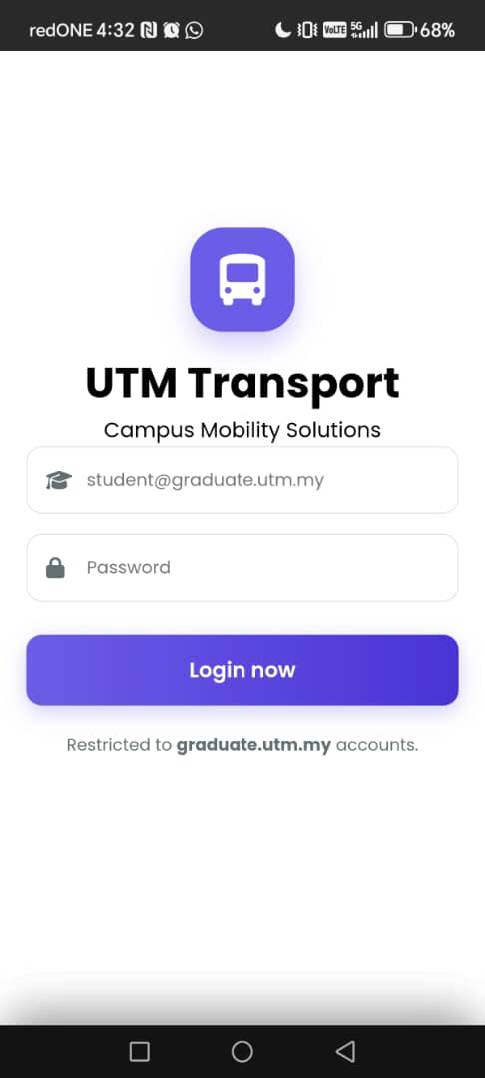

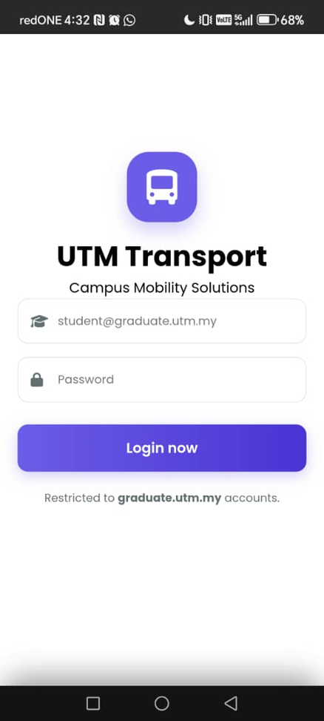


UTM TRANSPORT
NEW!
Optimizing Campus Connectivity
https://onedrive.live.com/personal/BEC61D1330939763/_layouts/15/Doc.aspx?sourcedoc=%7B2486791d-e867-41be-afc2-866b925167ba%7D&action=default&redeem=aHR0cHM6Ly8xZHJ2Lm1zL3AvYy9CRUM2MUQxMzMwOTM5NzYzL0lRQWRlWVlrWi1pLVFhX0NobXVTVVdlNkFVajVaVDZzS1MxeGVGTkxCNThzc0pJP2U9M0RnMWdQ&slrid=f880eba1-c0dc-a000-eb9e-11a764e377f2&originalPath=aHR0cHM6Ly8xZHJ2Lm1zL3AvYy9CRUM2MUQxMzMwOTM5NzYzL0lRQWRlWVlrWi1pLVFhX0NobXVTVVdlNkFVajVaVDZzS1MxeGVGTkxCNThzc0pJP3J0aW1lPXFlX1EzX1ZQM2tn&CID=98ffa69c-e243-4660-8df4-8c4db213fed8&_SRM=0:G:122&file=Presentation%20of%20design%20thinking%20project.pptx
Presented by:
DARREN CHUA BOON YEE A25CS0208
CHEW JIAN HUI A25CS0203
TAN IRENE A25CS0357
PON XUEN LIN A25CS0134
TAN YU KAI A25CS0144

Slide 2

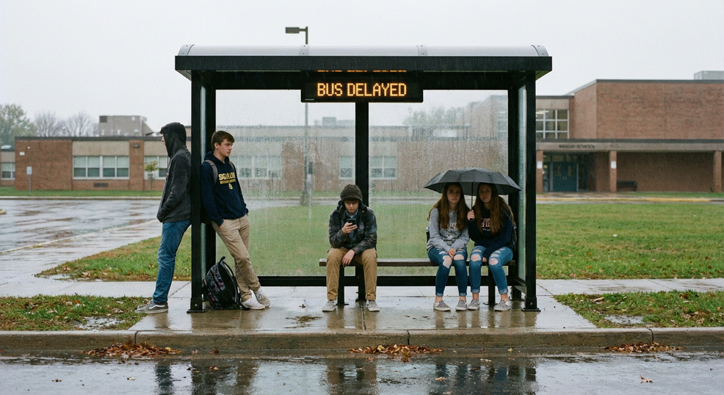
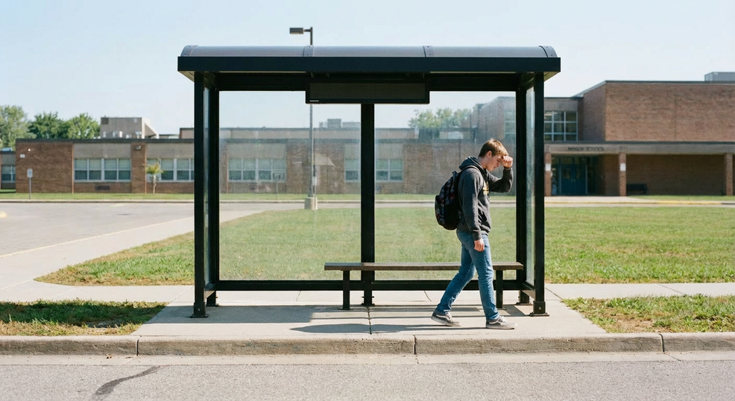









PROBLEM
Have you experienced ...
Long-time
waiting
Walking in hot weather
Unknown bus arrival time

Slide 3






UTM TRANSPORT
Navigate campus with ease.

Slide 4


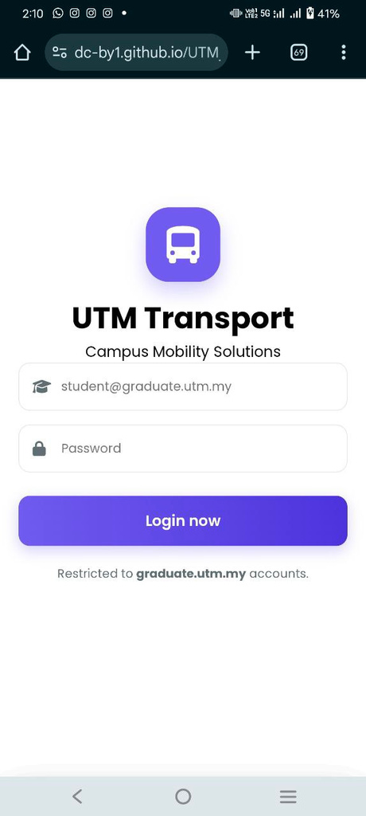
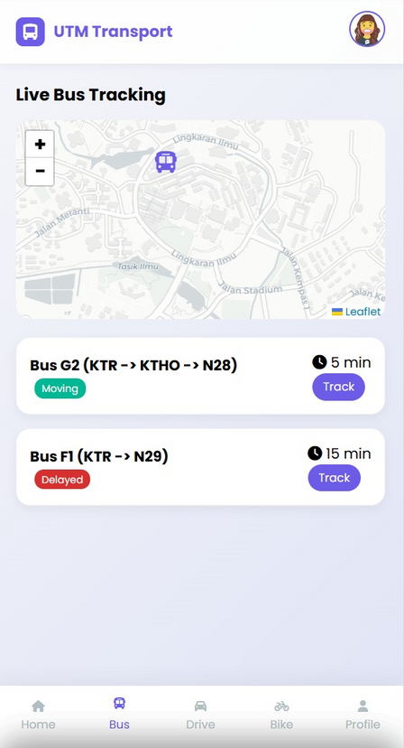
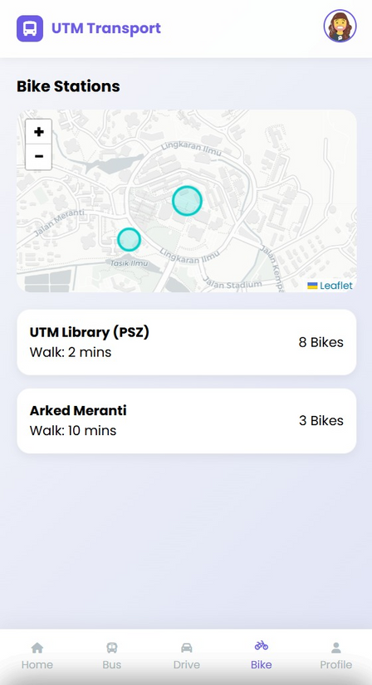
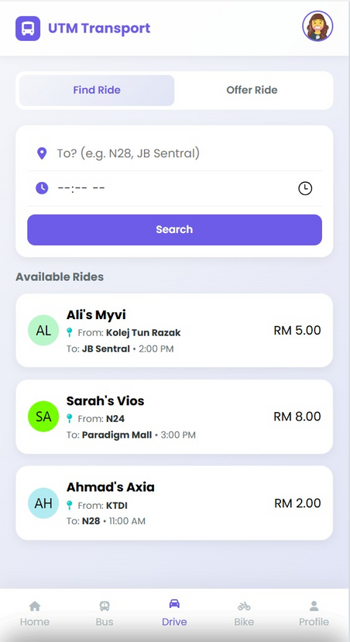


Features of UTM Transport
LOGIN
AUTHENTICATION
BUS TRACKER
BIKE RENTAL
BOOK & DRIVE

Slide 5
Features of UTM Transport

Slide 6



Welcome!
01
LOGIN AUTHENTICATION

Slide 7
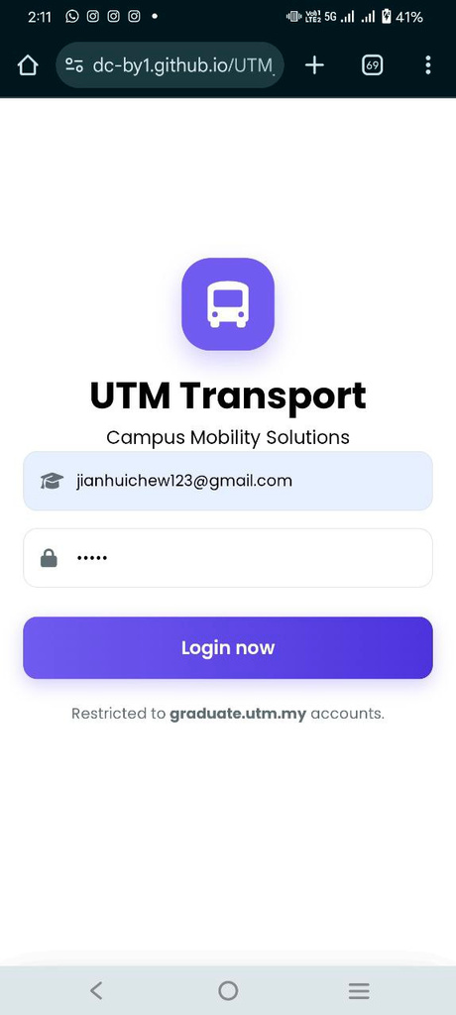
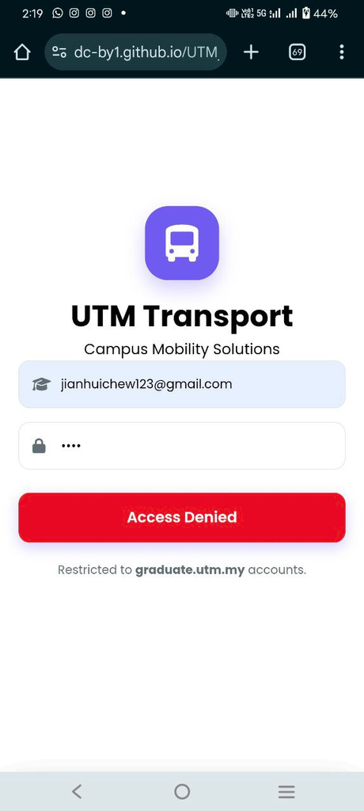

UNSUCCESSFUL LOGIN
Using Personal Email

Slide 8
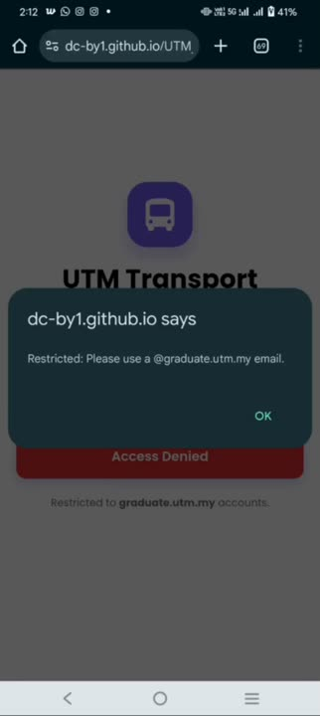


DEMONSTRATION

Slide 9
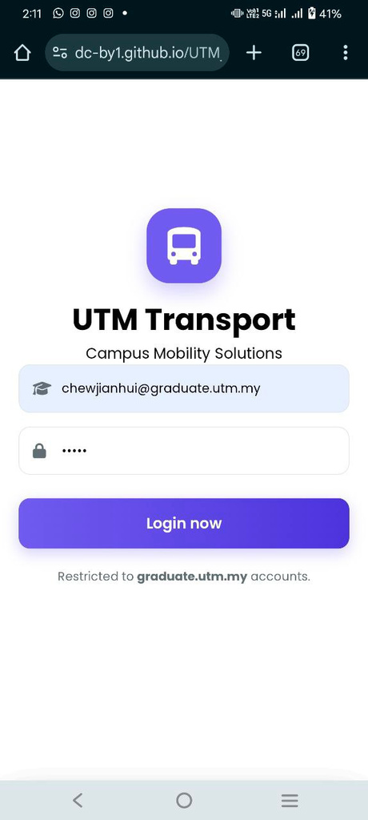
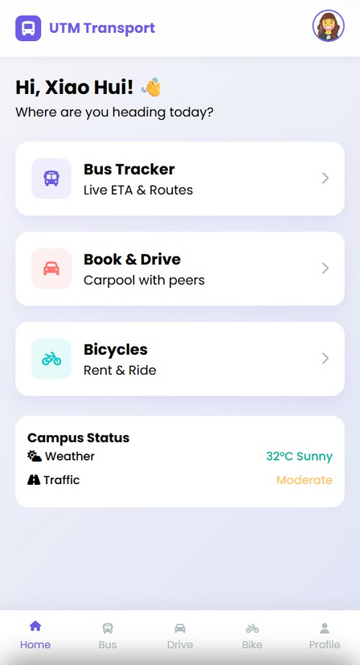
SUCCESSFUL LOGIN
Using
UTM Email

Slide 10
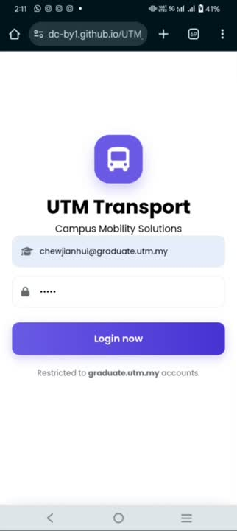


DEMONSTRATION

Slide 11

TRACK!
02
BUS TRACKER

Slide 12





Live Bus Tracking
Interactive Map
Real-time location of the bus on the map
Bus Information Panel
Show details: Bus name, route, status, estimated arrival time

Slide 13


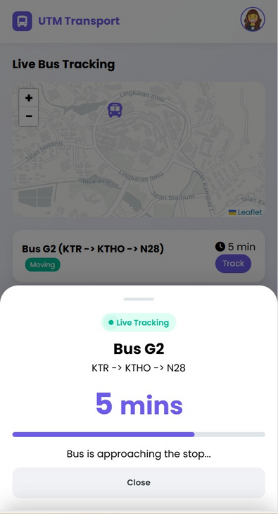

Two ideas
Click Track Button
Shows essential details and expected arrival time

Slide 14
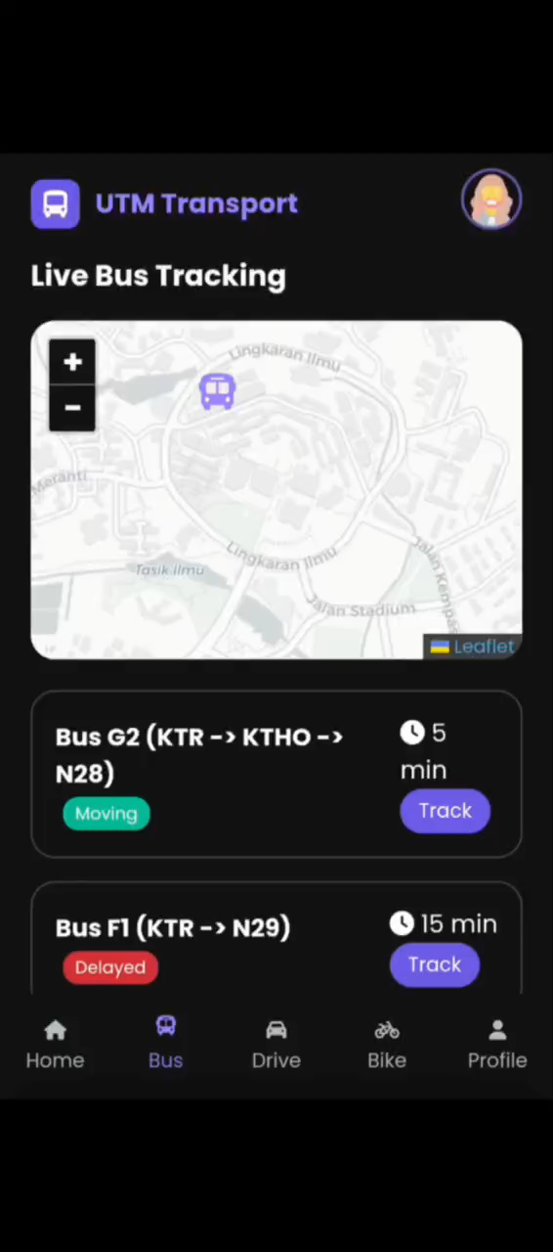

SAMPLE

Slide 15
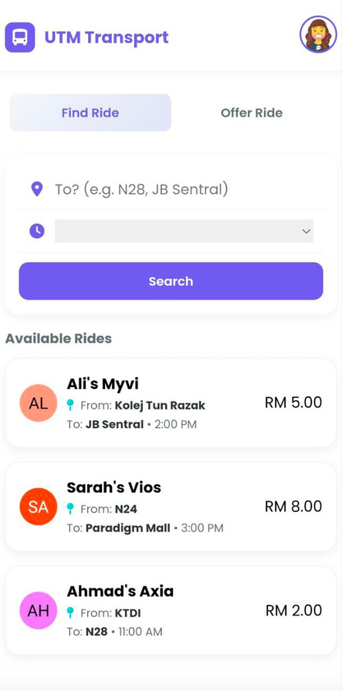
success!
03
BOOK
&
DRIVE

Slide 16






BOOK PAGE
Time
Destination
time to go
where you want to go
Name
Search
name of driver
search avaliable driver
Location
Price
location of driver
price that driver offer

Slide 17
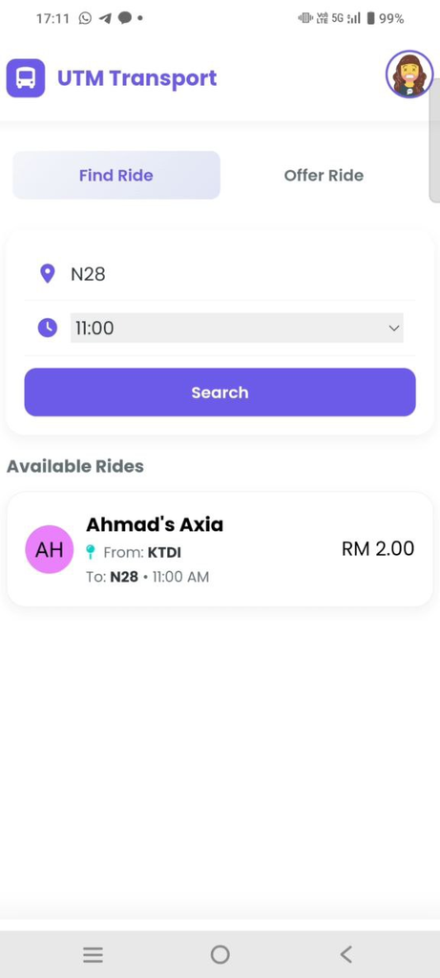
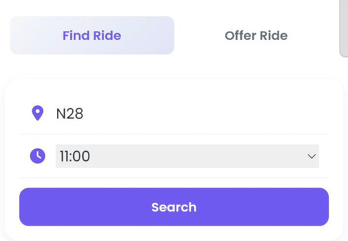
BOOK PAGE
Search Function

Slide 18
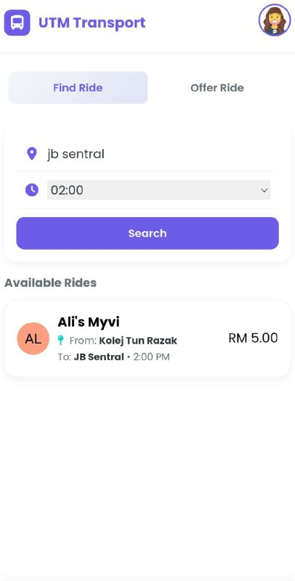
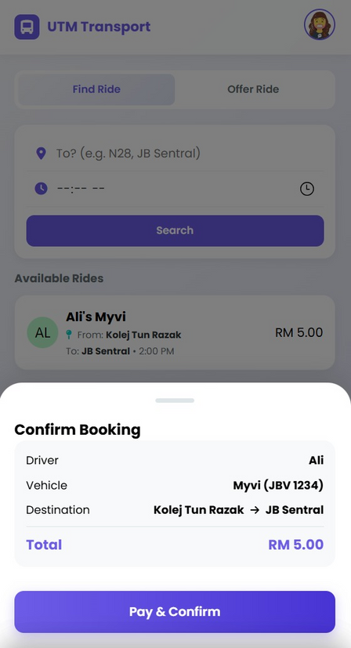
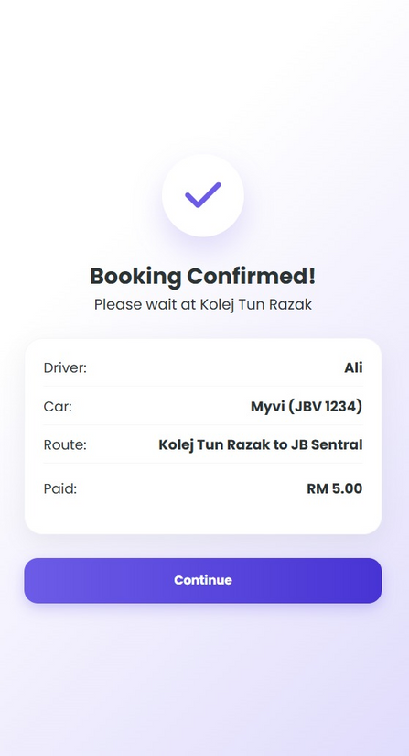
Book Function

Slide 19
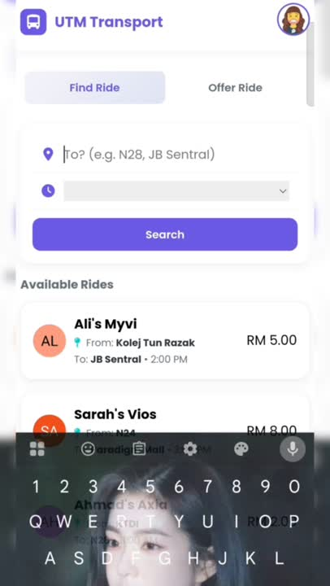
SAMPLE BOOKING

Slide 20
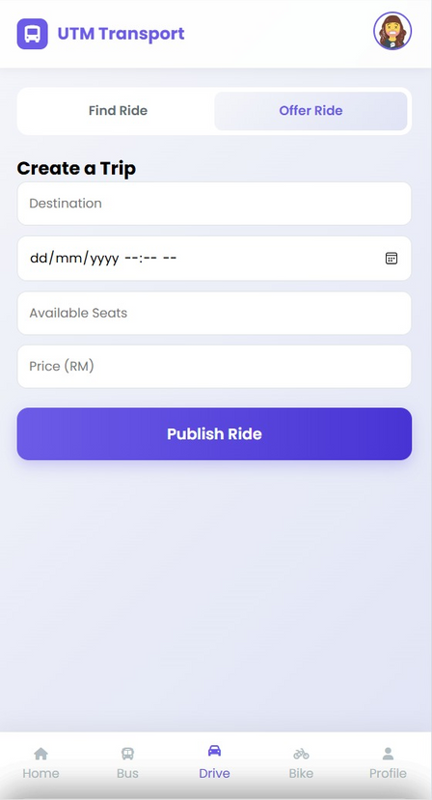
DRIVE PAGE
Time
Destination
Date & time to go
where you want to go
Seat
avaliable seat
Publish
Price
publish this ride to others
price that offer

Slide 21
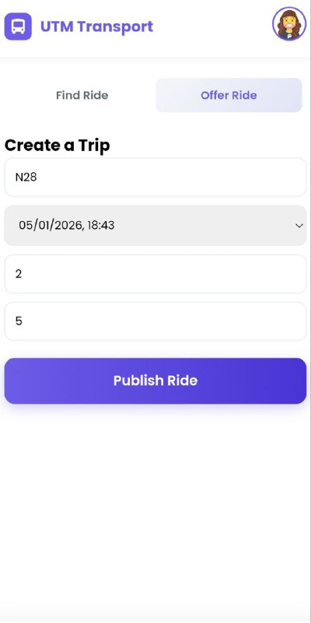
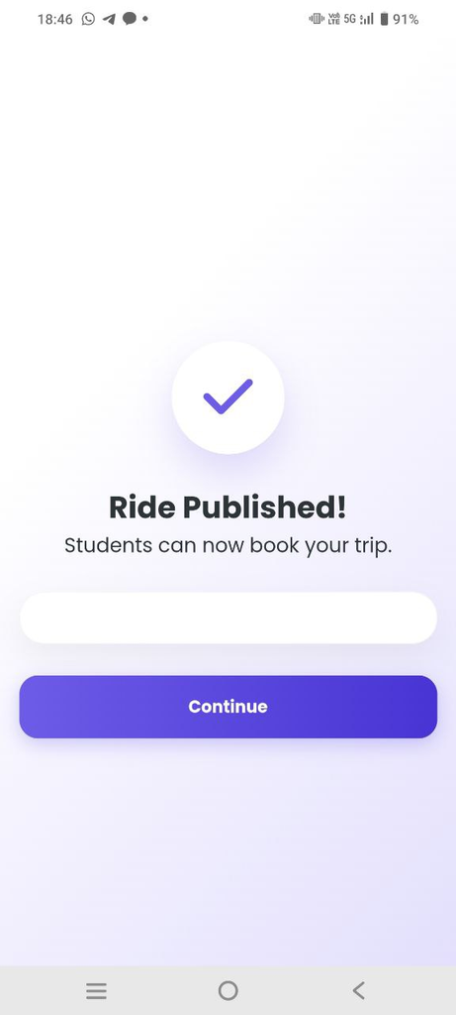
DRIVE PAGE
Publish Function

Slide 22
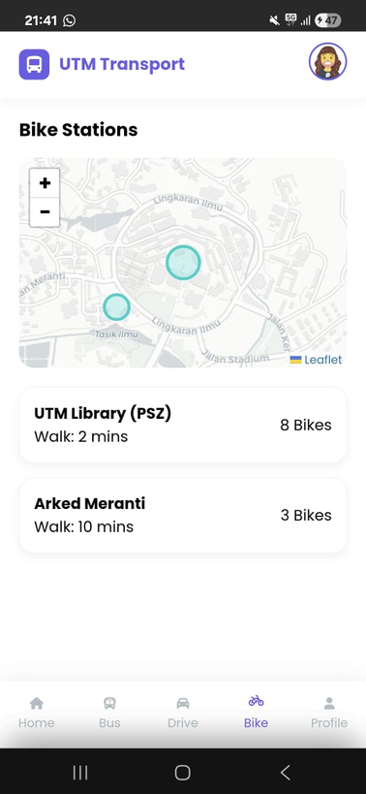


RENT IT!
04
Bike Rental

Slide 23

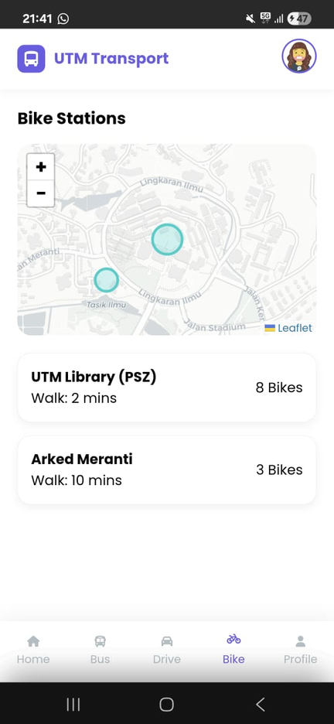



BIKE RENTAL FUNCTION
Location
Real-time location of the available bike in the campus
Amount
Real-time amount of the available bike in the campus

Slide 24
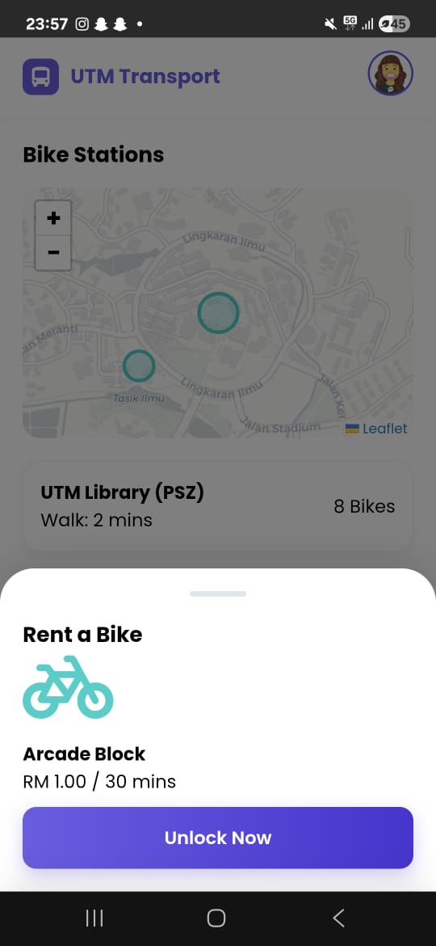


BIKE RENTAL FUNCTION
Price
The rental price for the bike for 30mins

Slide 25
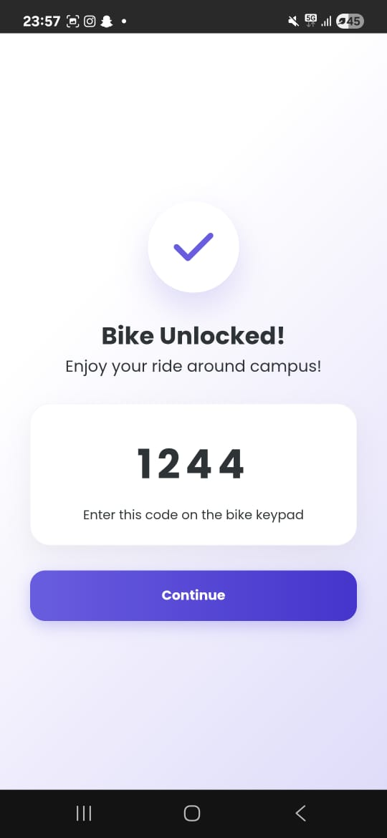


BIKE RENTAL FUNCTION
Code
The code that use to unlock the bike

Slide 26
BIKE RENTAL FUNCTION

Slide 27
BIKE RENTAL FUNCTION

Slide 28
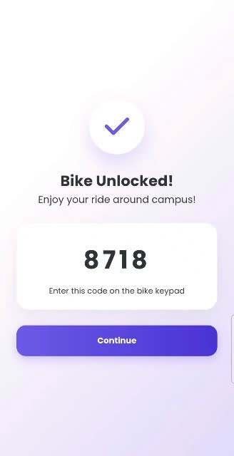


BIKE RENTAL DEMONSTRATION

Slide 29

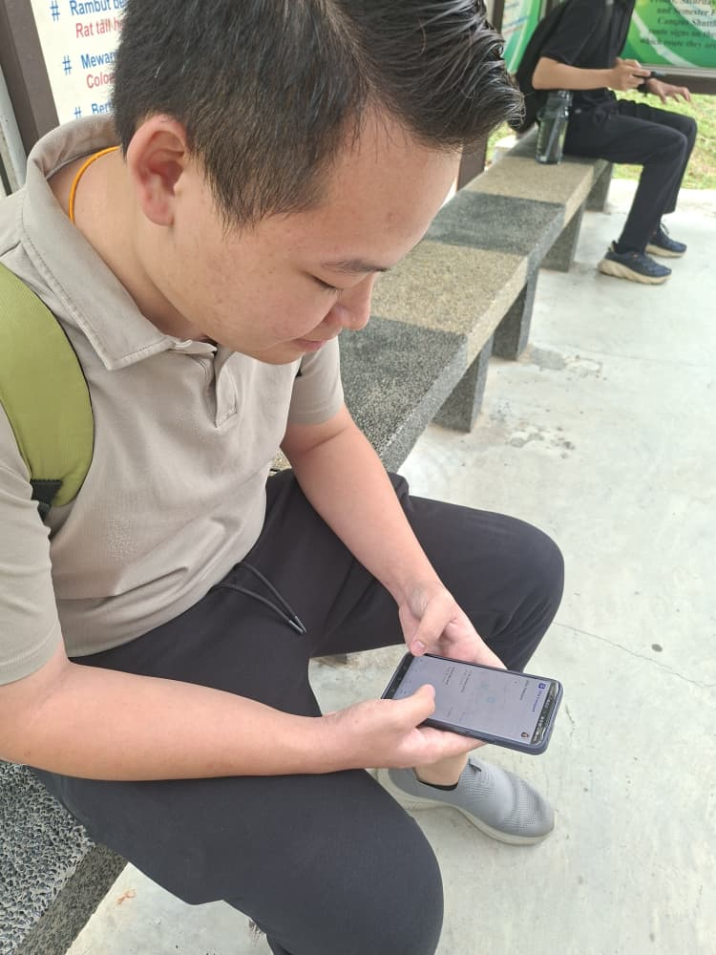
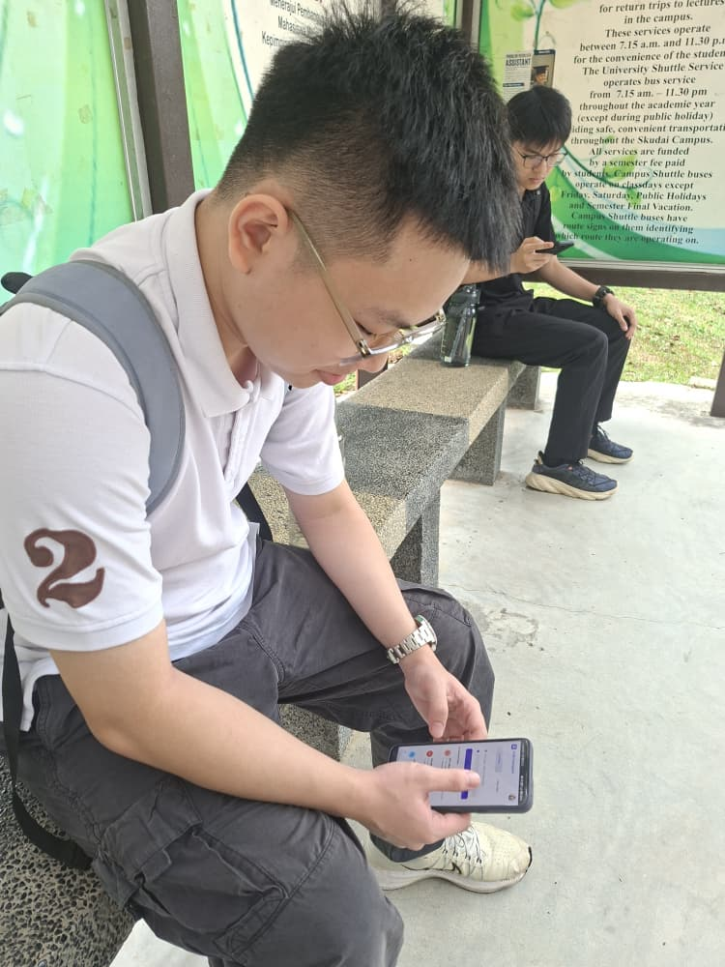

TESTING

Slide 30





FEEDBACK
”I no longer have to wait to find out when the bus will come because UTM Transport makes it much simpler to track buses in real time. For quick journeys around UTM, the bike rental facility is also quite helpful. ”
”The ride booking and ride offering features are very helpful, especially when public transportation is not available. Overall, this app greatly improves transportation convenience within UTM.”
Has UTM Transport been helpful to you?
Yes
80%
No
20%

Slide 31



THANK YOU

Slide 32
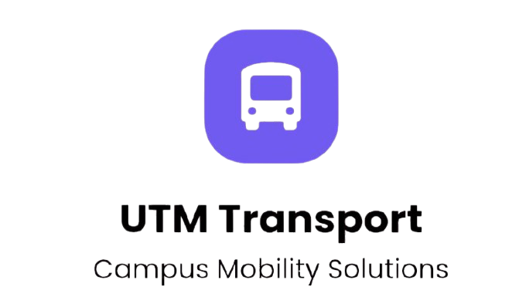
Q n A
Section

